Slide 1
Digital Thermometer
Project
Made by :
AIT MIMOUNE Yasmine
KESSOUM Mohamed Walid
ALAOUCHICHE Abderahmane Yaacoub
REBAHI Khadidja
BADAWI Aymen …

Slide 2

Introduction
Project Overview: Our project focuses on creating a digital thermometer using an LM35 sensor, Arduino Uno board, and Bluetooth module. We aim to develop a reliable and efficient temperature monitoring system with visual and audible indicators.

Slide 3
Objectives
Build a digital thermometer using the LM35 sensor and Arduino Uno board.
Set temperature thresholds and activate corresponding indicators (buzzer, red light) when the temperature exceeds these thresholds.
Implement a yellow LED indicator when the temperature is within a normal range.
Establish a Bluetooth connection between the Arduino and a smartphone using the HC-05 module.
Transmit temperature data from the Arduino to the BlueControl app for real-time visualization.
Provide an intuitive and user-friendly interface on the BlueControl app to display temperature readings.
Demonstrate the practical application of temperature monitoring in various scenarios.

Slide 4
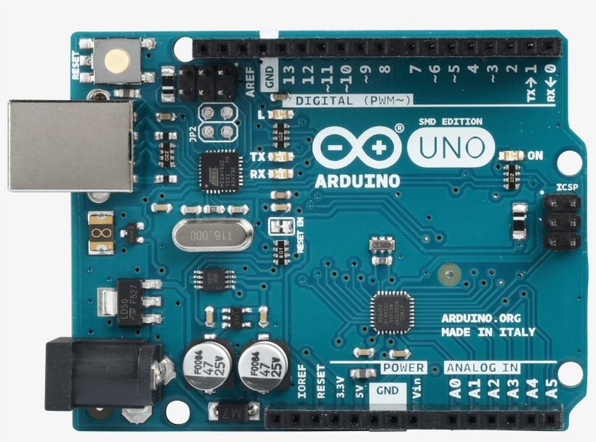
Circuit Components
Arduino UNO :
Role: The Arduino Uno board serves as the microcontroller for the project. It processes sensor data, controls the indicators, and establishes communication with the Bluetooth module.
Features: It has digital and analog input/output pins, a USB interface for programming and power supply, and onboard power regulation.

Slide 5
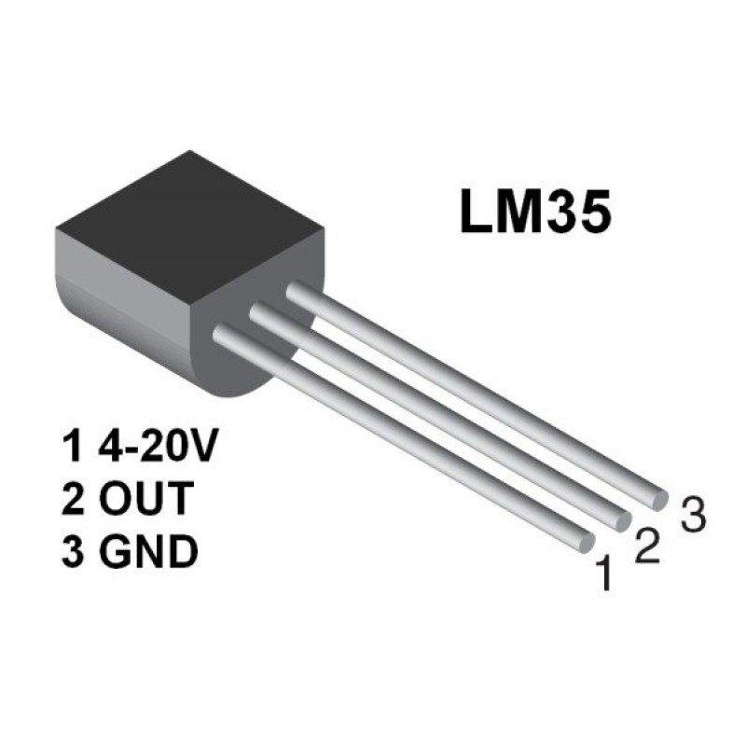
Circuit Components
LM35 Sensor :
LM35 is a 3 pin temperature sensor which gives 1 degree Celsius on every 10mVolt change. This sensor can sense up to 150 degree Celsius temperature. 1 number pin of lm35 sensor is Vcc, second is output and third one is Ground. LM35 is the most simplest temperature sensor and can be interfaced easily with any microcontroller.

Slide 6
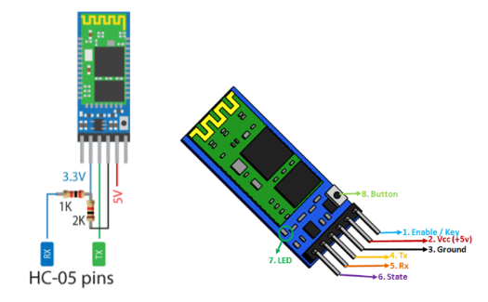
Circuit Components
HC-05 Bluetooth Module :
Purpose: The HC-05 module enables wireless communication between the Arduino and a smartphone. It allows the transmission of temperature data from the Arduino to the BlueControl app. Features: The HC-05 module supports Bluetooth 2.0 and Serial Port Profile (SPP), making it compatible with a wide range of devices.

Slide 7
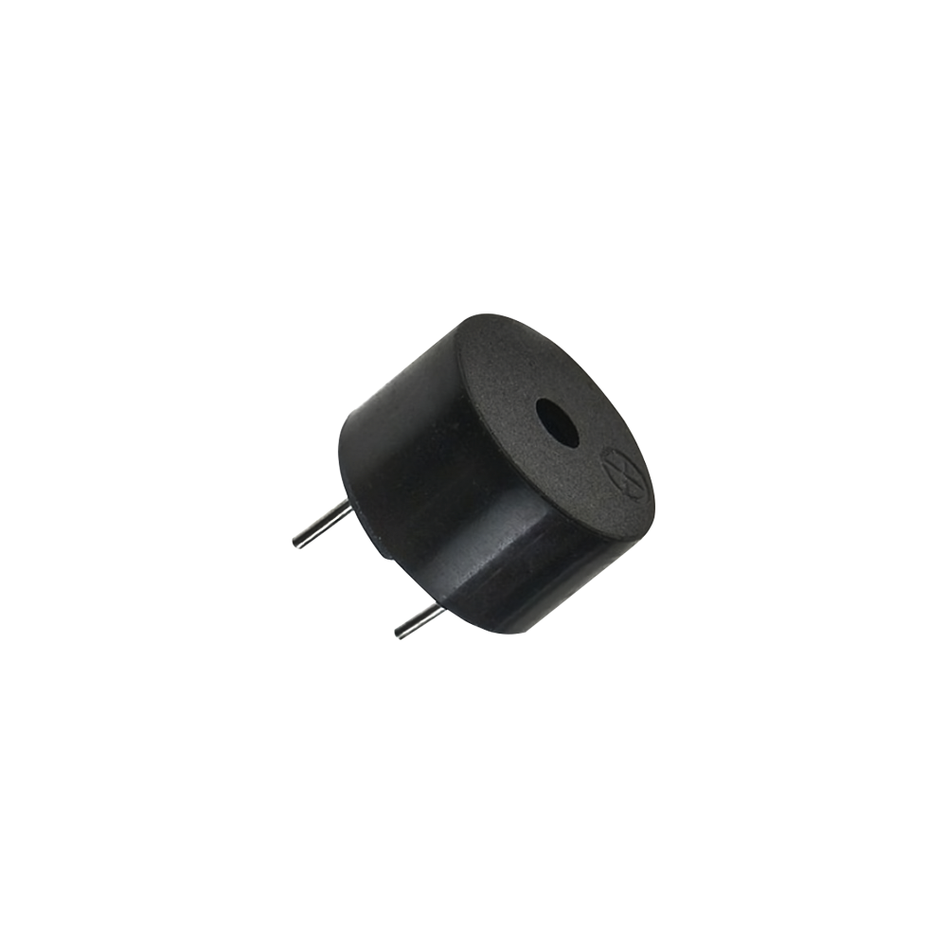
Circuit Components
Buzzer
Function: The buzzer serves as an audible indicator in our digital thermometer project. It emits a sound when the temperature exceeds predefined thresholds.
Working Principle: The Arduino is programmed to activate the buzzer when the temperature reading surpasses the specified thresholds, providing an alert signal.

Slide 8
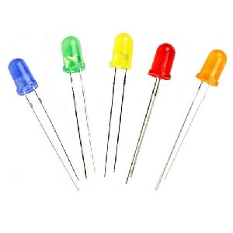
Circuit Components
LEDS
Red LED: Function: The red LED acts as a visual indicator, indicating that the temperature has exceeded a critical threshold. Activation: When the temperature reaches or surpasses the critical threshold, the Arduino triggers the red LED to turn on, providing a clear visual indication.
Yellow LED: Function: The yellow LED serves as a visual indicator to show that the temperature is within the normal range. Activation: When the temperature remains within the normal range, the Arduino activates the yellow LED to stay on, indicating a stable temperature condition. Control: The Arduino's programming allows for precise control of the LEDs, ensuring they respond accordingly to temperature conditions.

Slide 9
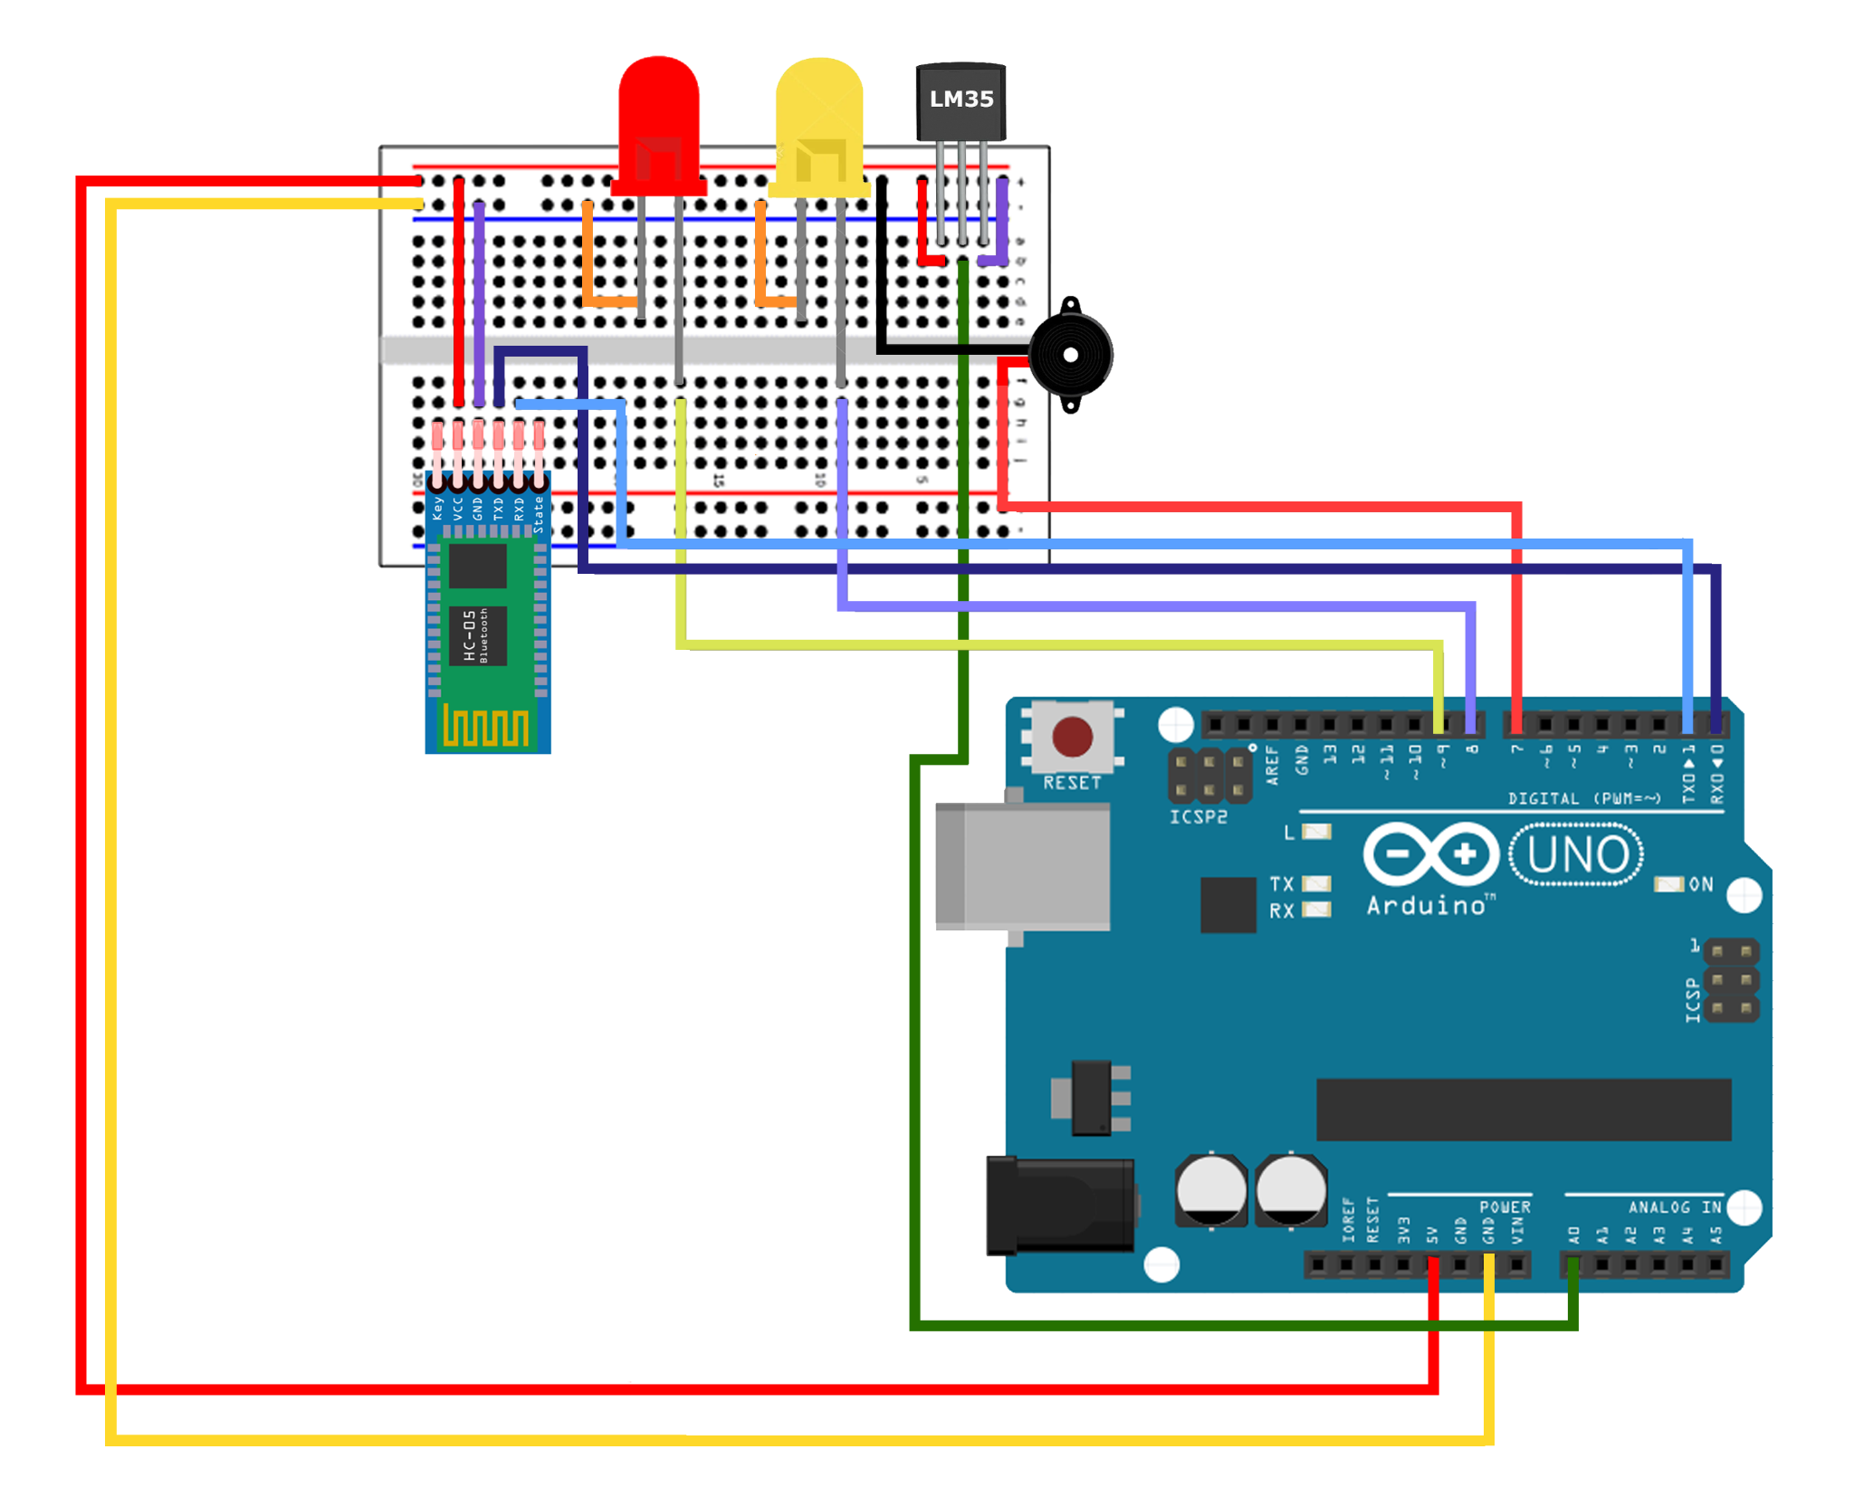
Circuit Diagram
The circuit connections are as follows:
The LM35 temperature sensor is connected to one of the analog input pins on the Arduino to measure the analog voltage output. The LEDs are connected to digital output pins on the Arduino, allowing them to be controlled and indicate different temperature levels. The buzzer is connected to a digital output pin on the Arduino to produce sound alerts. The HC-05 Bluetooth module is connected to the RX (Receive) and TX (Transmit) pins of the Arduino to establish bidirectional serial communication for data transmission.

Slide 10
Procedure
1. Connect it all together
After realising the circuit, plug the arduino to your laptop. (DO NOT CONNECT RX and TX Before/While plugging)
2.Install the arduino IDE
We’re not gonna go into details in this, launch the program after installation.

Slide 11
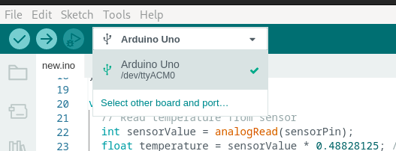
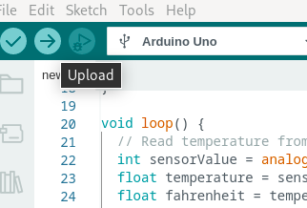
Procedure
3. Select the board :
Select your arduino board on the menu .
4.Upload your code
Upload your code and start monitoring.

Slide 12
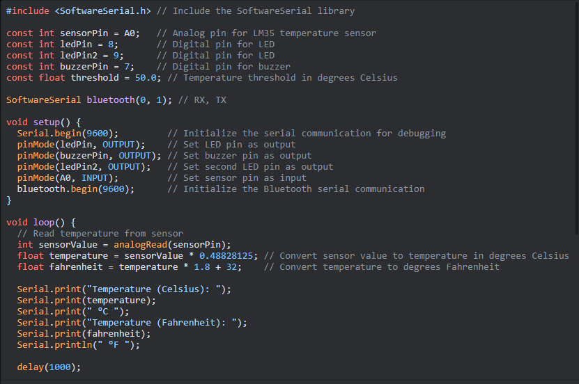
Code :

Slide 13
Features and Functionality
The project integrates an LM35 sensor and an Arduino Uno board to construct a functional thermometer.
The LM35 sensor provides analog voltage output proportional to the surrounding temperature, connected to the Arduino Uno's analog input pin.
The Arduino Uno reads the sensor's analog voltage and converts it into a digital value using its built-in analog-to-digital converter.
The converted digital value represents the temperature reading, processed by the Arduino Uno.
The Arduino Uno configures temperature thresholds and activates indicators (buzzer, red light, yellow LED) for warnings if thresholds are exceeded.

Slide 14
Features and Functionality
The Arduino Uno establishes a Bluetooth connection with a smartphone to transmit real-time temperature data.
The Bluetooth module on the Arduino Uno communicates with the smartphone, sending temperature readings over the Bluetooth connection.
The BlueControl app on the smartphone receives and visualizes the temperature data in real-time.
The App displays temperature readings on the smartphone screen, enabling convenient monitoring of temperature changes.
The project provides an effective and user-friendly solution for temperature monitoring with configurable alerts and real-time visualization on a smartphone.

Slide 15
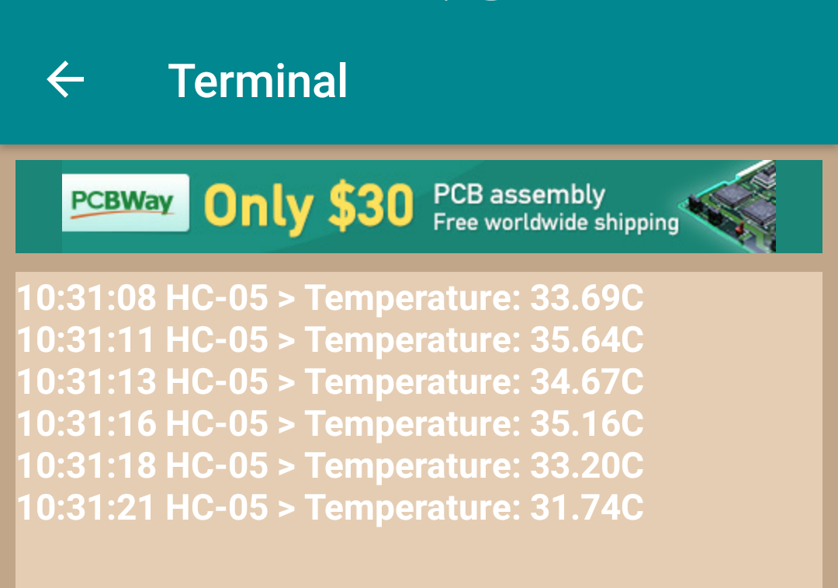
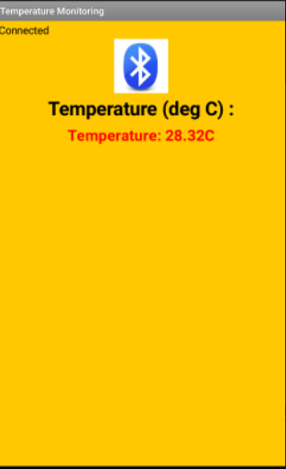
Results :
We can use different application to view the results :

Slide 16
Challenges
Understanding and calibrating the LM35 sensor for accurate temperature readings.
Troubleshooting connectivity issues between the Arduino and the HC-05 Bluetooth module.
Programming the Arduino to properly control the indicators based on temperature thresholds.

Slide 17
Solutions and Lessons Learned:
Gaining hands-on experience in working with sensors, microcontrollers, and Bluetooth modules. Enhancing programming skills for Arduino and understanding hardware-software integration.
Developing troubleshooting and problem-solving abilities in electronics and programming projects. Future Improvements

Slide 18
Conclusion
In conclusion, the digital thermometer project was a success. We successfully built a thermometer with configurable temperature thresholds and a user-friendly visualization interface on a smartphone. This project demonstrates the practical application of Arduino, sensors, and wireless communication in the field of connected devices. We are grateful for the opportunity to work on this project which provided us with valuable experience and deepened our understanding of the possibilities offered by connected devices.

